Slide 1


Slide 2
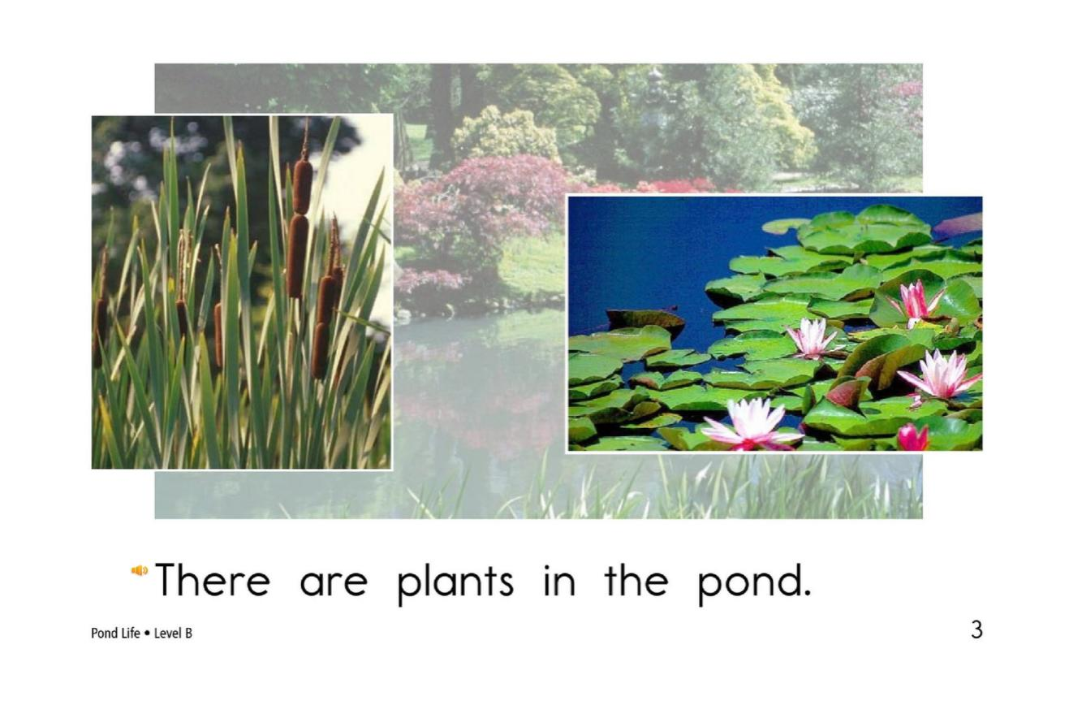
return

Slide 3
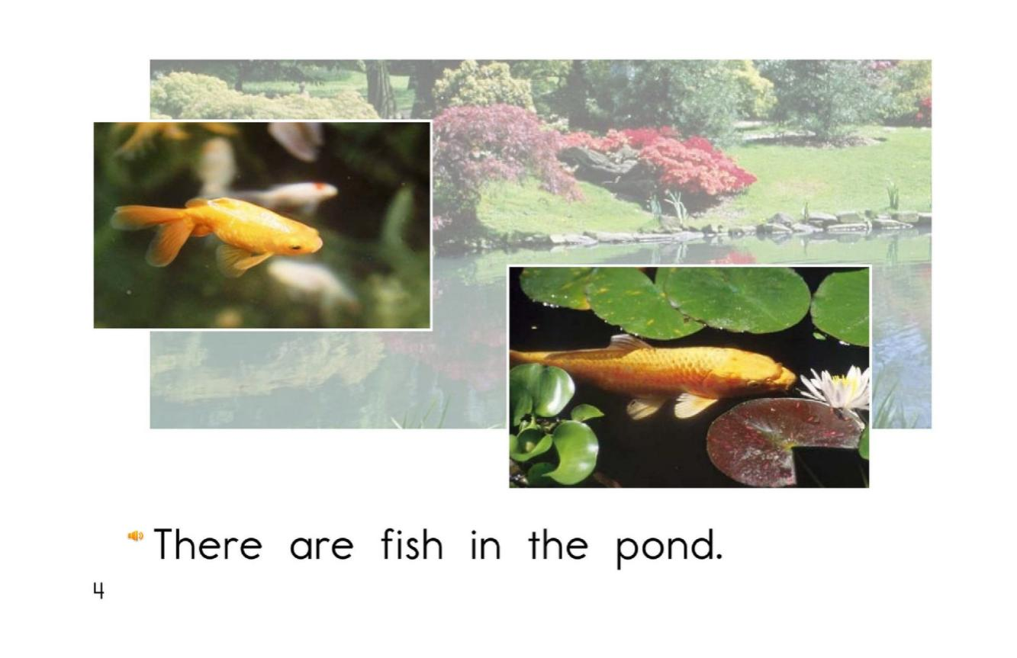
return

Slide 4
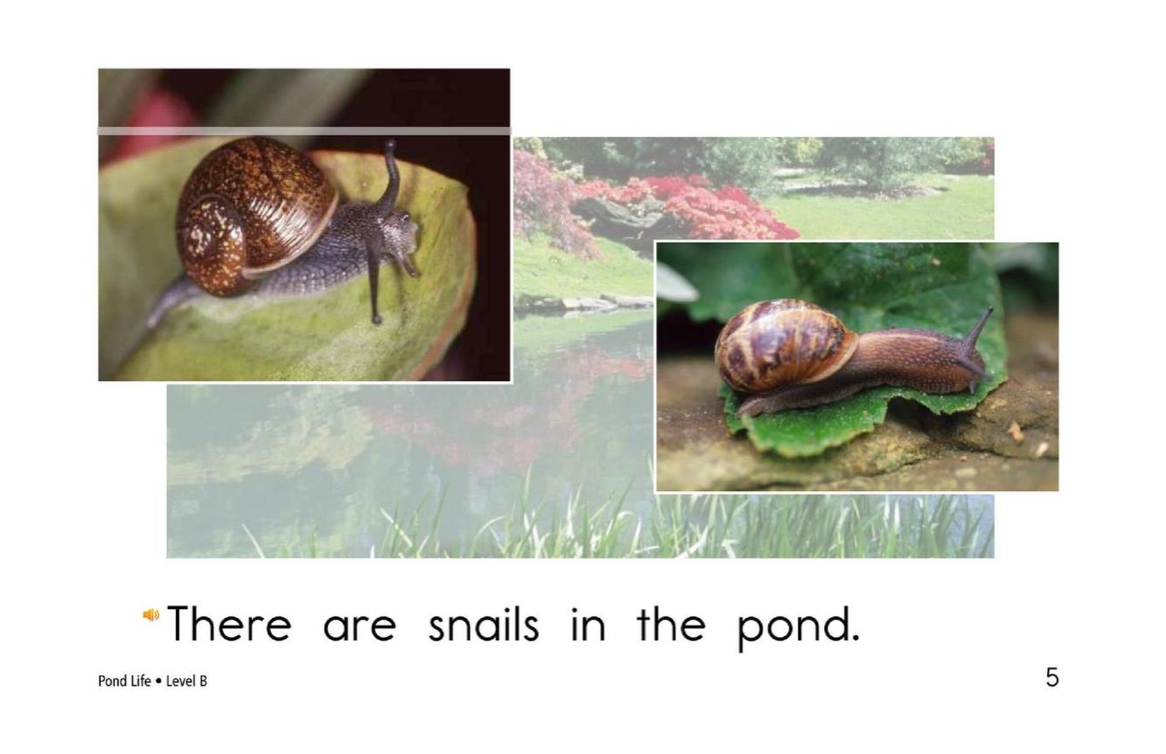
return

Slide 5
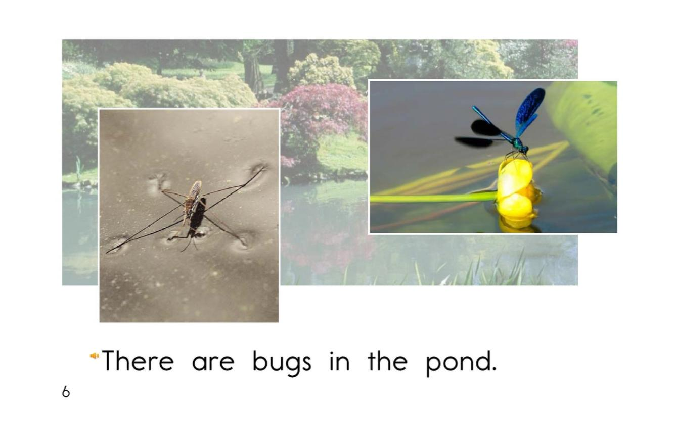
return

Slide 6
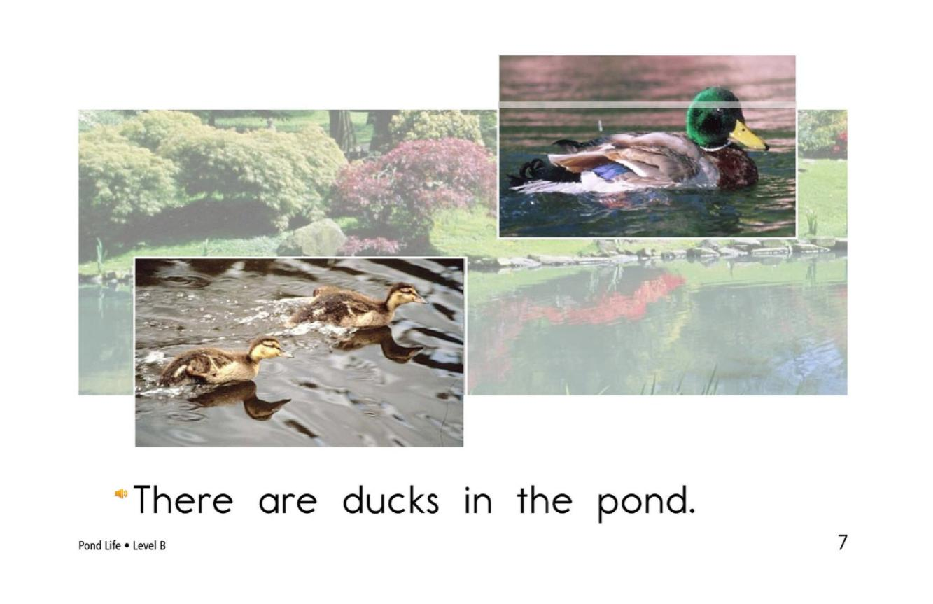
return

Slide 7
plant
fish
snail
bug
duck
Click on the colored buttons to start getting to know them!

